Slide 1
ECS8052 Knowledge Engineering
Approximate Inference

Slide 2
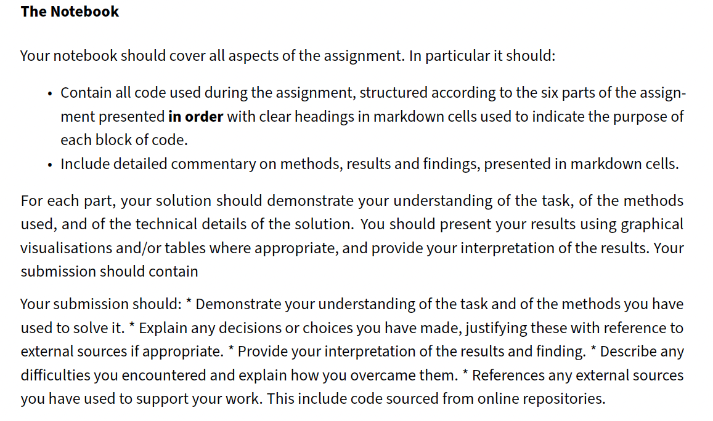
Assignment 1 Feedback
Individual feedback has been released this morning
PROVISIONAL AND SUBJECT TO MODERATOR REVIEW
Some general comments:
Technically most submissions were at least competent
Nearly all submissions made a genuine and serious attempt.
Many excellent submissions.
The main issue with most submissions was lack of explanation/commentary.

Slide 3
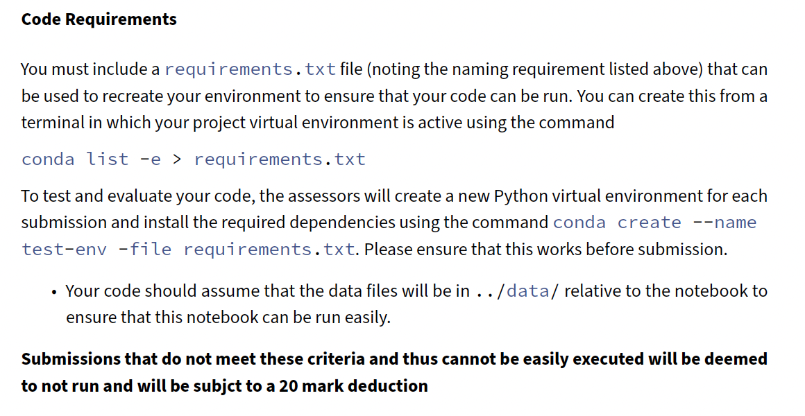
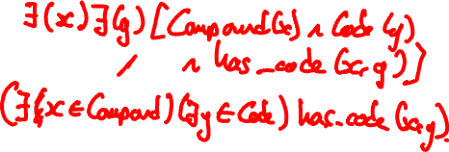
Assignment 1 Feedback
Follow the instructions
Point the code to where I tell you the data will be
There were a small but significant number of submissions where the code did not run. This was mostly for trivial reasons such as mis-spelled variable names.
Part 5 (Logic) – quite a few solutions were overcomplicated (eg including additional predicates).
Many submissions included static graphs with poor layouts, overlapping nodes, failure to handle multiple edges etc
I will issue revised guidance on what is required for assignment 2.

Slide 4
Recap
Last we showed how to perform exact computations on Bayesian Networks
Not efficient for very large systems of discrete variables
Not possible for networks with continuous variables

Slide 5
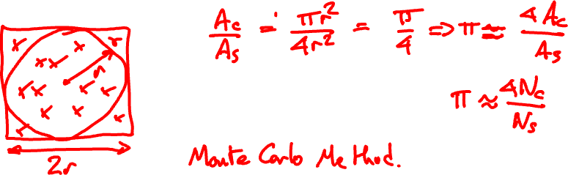
Approximate Inference
Recap: Monte Carlo sampling approach

Slide 6
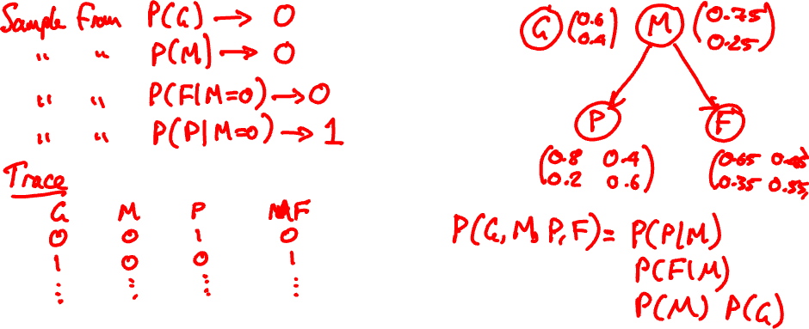
How do we apply this to Bayesian Networks

Slide 8
Importance Sampling
Discrete sampling indiscriminately samples the whole sample space
Can support multiple queries
But for answer a specific question, very inefficient
Imagine we want to know P(M | P=True, G=False).
We can sample the whole space and use rejection sampling
Many samples go unused…
Can we just sample the subset that we want?
Yes – we can fix the conditvariables

Slide 9
Likelihood weighting
Imagine we have some evidence that means some variables should be fixed – evidence variables
The evidence must by definition be consistent with the posterior distribution
Sampling from the sample subspace that supports the evidence must take this into account
Not all evidence is equally well supported – we should account for the probability that a sample is more or less supportive of the evidence
This is the principle behind likelihood weighting

Slide 10
The Likelihood Weighting Algorithm
Fix all the evidence variables to their observed values
Sample non-evidence variables conditioned on the fixed evidence variables
Compute the probability that the sample you have just drawn would give rise to the evidence that you have fixed.
Include your sample in the trace, weighted by this probability.

Slide 11
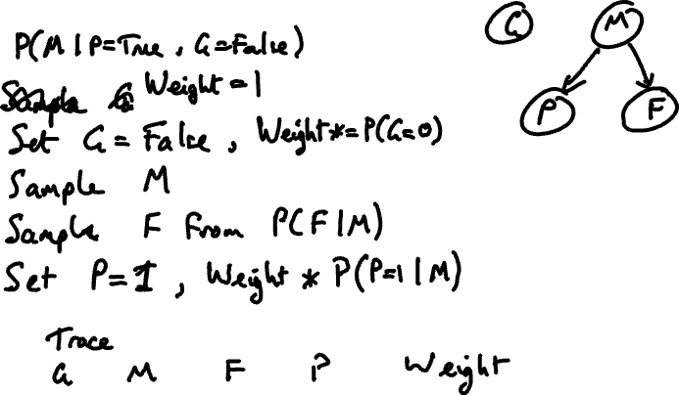
Example

Slide 12
Calculating from a weighted trace

Slide 13
Why does this work?
All of the samples generate have the observed values of the evidence variables and so all of the samples can be used.
Improved accuracy (more samples) or faster convergence for a given level of accuracy.
Can be shown rigorously that weighting of the likelihoods in this way is fully consistent with direct sampling from the desired posterior distribution.

Slide 14
Markov Chain Monte Carlo
Discrete sampling and its variants all generate samples independently.
A new sample in the trace has no knowledge of any previous samples that have been generated.
A very common alternative treats the sampling as a *Markov Chain* in which the generation of the next sample depends on the current sample, but not on events prior to the current sample.
Markov Chain Monte Carlo (MCMC) sampling methods generate each successive sample by randomly modifying the current sample.
Gibbs Sampler is especially well suited for Bayesian Networks.

Slide 15
Gibbs Sampling
The Gibbs sampler is a Markov Chain
States are generated by making modifications to the current state
Begin by fixing all evidence variables to their observed values. These will not be changed through the sampling process.
Initialise all of the non-evidence variables to random values.
Initial values must be supported by the distribution attached to the variable but there are no other requirements.
A new state is created by sampling *one* of the non-evidence variables, chosen at random.
The sampling of the chosen variable will be from its conditional probability distribution which is implicitly or explicitly conditioned on its Markov Blanket

Slide 16
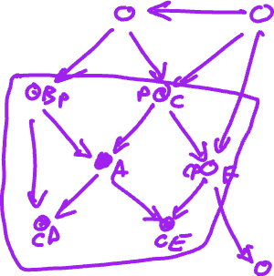
Markov Blanket
The set of variables that are either parents or children of the chosen variable, or are co-parents of the variable's children
Any variable is conditionally independent of all variables outside of its Markov blanket

Slide 17
Gibbs Sampling
The Gibbs sampler determines its outcome by counting how many times it visits each state and normalising.
If it visits a state where M is True forty-five times, and M is False fifteen times, the resulting distribution is P(M|F) = 45/60
The Gibbs sampler settle into an equilibrium in which it visits states according to a distribution that is equivalent to the posterior
Needs to reach that equilibrium – requires a burn-in period
Tricky to implement – we use a library: pymc

